Slide 1
INFRASTRUCTURE SETUP
Group Cybersecurity Home Lab
Attack, Defend & Monitor
Core Objective
Observation
Scope
Build a functional lab for offensive testing and central monitoring.
Monitor network traffic and security events in real-time.
Isolated virtual network for safe traffic generation and discovery.

Slide 2




Lab Architecture & Topology
VirtualBox Bridged Network Configuration
Kali Linux
Metasploitable
Wazuh
Attacker
Target
Security Monitor
Bridged Adapter Mode
Assigns individual local IPs directly from the router, enabling seamless inter-VM communication on a single subnet.

Slide 3

Component 1 - Kali Linux
The Offensive Node
nmap
Network discovery and open port scanning.
ping
ICMP reachability and uptime testing.
Attacker Machine
Specialized Linux OS optimized for ethical hacking and deep security auditing.
metasploit
Exploitation framework for launching attacks.

Slide 4




Component 2 - Metasploitable 2
The Vulnerable Target
Role
Operating System
Intentionally vulnerable target designed for testing.
Legacy Ubuntu Linux environment.
Purpose
Deployment
Safe, legal network target pre-configured with known vulnerabilities.
Operates openly without monitoring agent installation.

Slide 5



Component 3 - Wazuh OVA
The Security Platform
Security Information and Event Management (SIEM) for real-time log analysis.
Wazuh Manager
Wazuh Indexer
Wazuh Dashboard
Central engine analyzing incoming log data.
Search engine and storage for security logs.
Web GUI for visual threat monitoring and alerts.

Slide 6
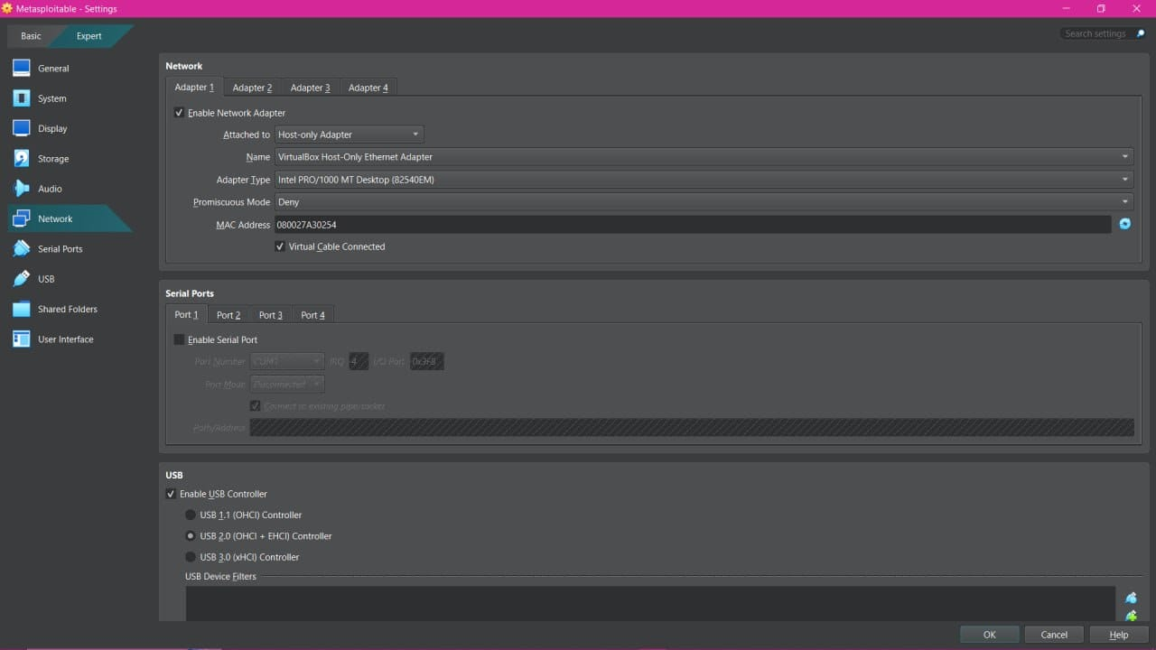




VirtualBox Deployment
Metasploitable 2 Setup
Disk Extraction
Downloaded and extracted the .vmdk file.
Direct Attachment
Attached disk directly to bypass OS installation.
[ Insert VirtualBox Screenshot ]
Network Bridging
Configured settings to Bridged Adapter.

Slide 7
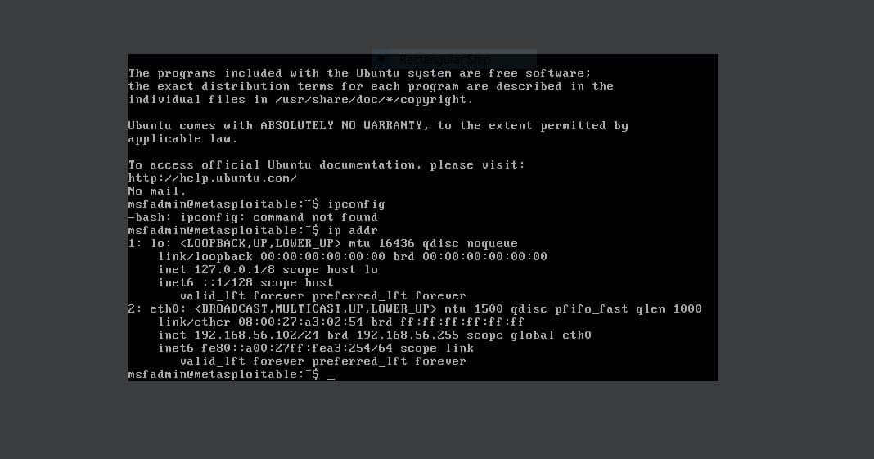

Network Identification
Metasploitable 2 IP Setup
COMMAND EXECUTED
Ip addr
Function
[ Insert ifconfig Screenshot ]
Displays active network interfaces and connections.
Purpose
Identifies target IP address for attack aiming.

Slide 8
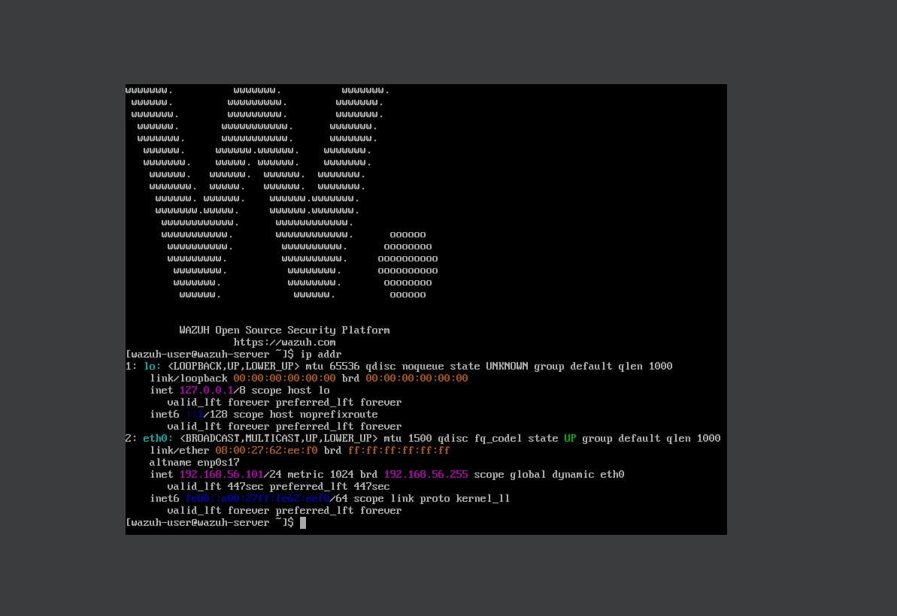
Network Identification
Wazuh OVA IP Setup
COMMAND EXECUTED
ip a
Function
Modern utility listing network interfaces and IPs.
[ Insert ip a Screenshot ]
Purpose
Locates management IP for dashboard browser access.

Slide 9
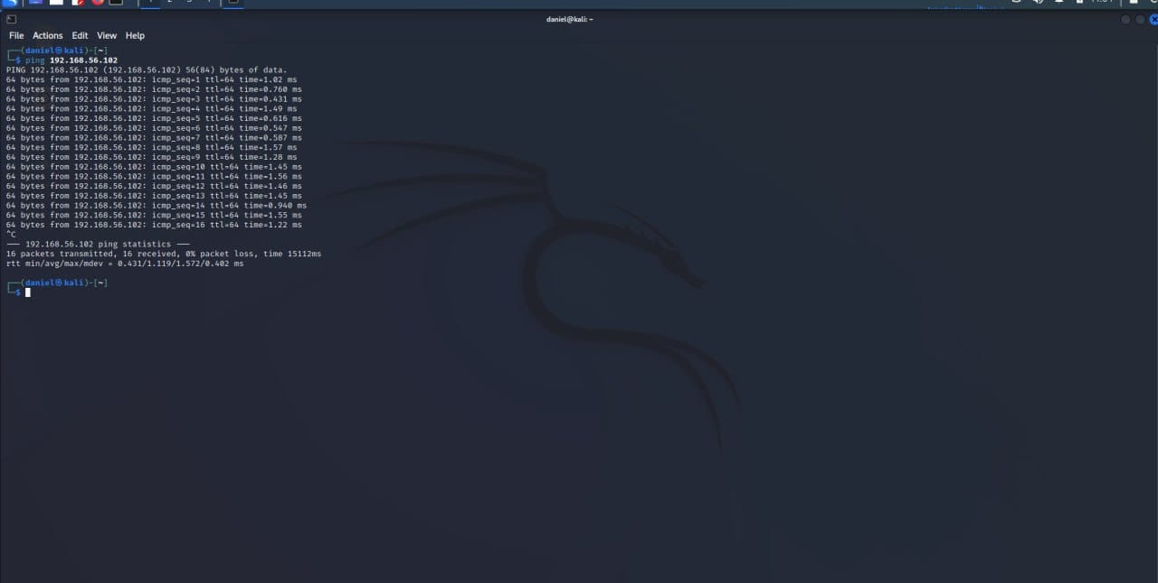
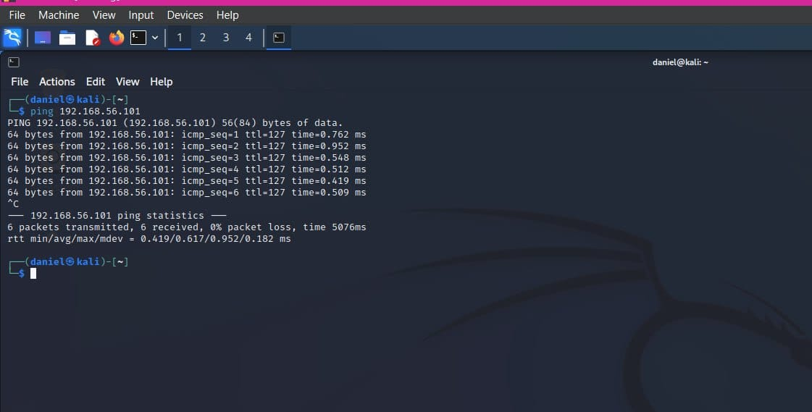
Connectivity Verification
Ping Tests
COMMANDS EXECUTED
ping [Metasploitable IP] 192.168.56.102
ping [Wazuh IP] 192.168.56.101
Function
Sends ICMP Echo Requests to verify connectivity.
Purpose
Ensures all machines can communicate before scanning.

Slide 10
Key Takeaways & Lessons Learnt
Lab Insights and Outcomes
Isolated Environments
Visibility is Critical
Bridged networking provides safe, isolated spaces for offensive technique practice.
Centralized SIEM logging exposes network scans and attacks in real-time.

Slide 11
Thank You

